Slide 1
Extreme Fake it till you make it
@LlewellynFalco

Slide 2

https://github.com/isidore/Talks/blob/master/FakeItTillYouMakeIt.md

Slide 3
“I had the mental image of knobs on a control board. Each knob was a practice that I knew worked well from experience . I would turn all the knobs up to 10 and see what happened...” - Kent Beck (paraphrased)

Slide 4
Agile

Slide 5
TDD
SmallReleases
Feedback
PairProgramming
BDD
SustainablePace
IterativeDevelopment
Devops
Microservice
Release planning
WholeTeam
ContinuousIntegration
SimpleDesign
MobProgramming

Slide 6
TDD
SmallReleases
Feedback
PairProgramming
BDD
SustainablePace
IterativeDevelopment
Devops
Microservice
Release planning
WholeTeam
ContinuousIntegration
SimpleDesign
MobProgramming

Slide 7
RED
REFACTOR
GREEN

Slide 8
Code Smells
Toolings
Naming
Patterns
Fake It till you make it
Refactorings

Slide 9
Code Smells
Toolings
Naming
Patterns
Fake It till you make it
Refactorings

Slide 10
Triangulation
Derivation

Slide 11
Triangulation
Derivation

Slide 12
Triangulation

Slide 13
Line

Slide 14
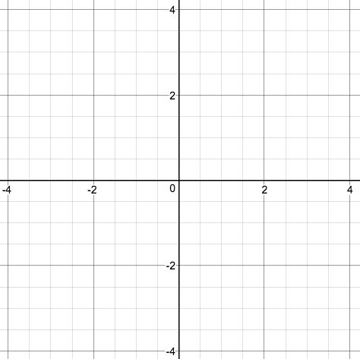
Line
2

Slide 15
Line
[TestMethod]
public void TestHorizontalLength2()
{
// Create a Line from 0,0 to 2,0
// verify the length is 2
}

Slide 16
Line
[TestMethod]
public void TestHorizontalLength2()
{
var line = new Line(0, 0, 2, 0);
Assert.AreEqual(2, line.Length);
}

Slide 17
Line
[TestMethod]
public void TestHorizontalLength2()
{
var line = new Line(0, 0, 2, 0);
Assert.AreEqual(2, line.Length);
}
public int Length {
get { return 2; }
}

Slide 18
Line
4

Slide 19
Line
[TestMethod]
public void TestHorizontalLength4()
{
var line = new Line(0, 0, 4, 0);
Assert.AreEqual(4, line.Length);
}

Slide 20
Line
get { return x2-x1; }

Slide 21
Line
4

Slide 22
Line
[TestMethod]
public void TestVerticalLength4()
{
var line = new Line(0, 0, 0, 4);
Assert.AreEqual(4, line.Length);
}

Slide 23
Line
get
{
var x = x2-x1;
var y = y2-y1;
return x + y;
}

Slide 24
Line
5

Slide 25
Line
public void TestDiagonal()
{
var line = new Line(0, 0, 4, 3);
Assert.AreEqual(5, line.Length);
}

Slide 26
Line
public double Length
{
get
{
var x = x2 - x1;
var y = y2 - y1;
return Math.Sqrt(x*x + y*y);
}
}

Slide 27
derivatization

Slide 28
Line
var x = x2-x1;
return x;
return 2;

Slide 29
Line
return 2;

Slide 30
Line
Separate
return 2 - 0;
1

Slide 31
Line
Calculate
return x2 - 0;
2

Slide 32
Line
Calculate
return x2 – x1;
3

Slide 33
Line
Encapsulate
var x = x2-x1;
return x;
4

Slide 34
Phone Number

Slide 35
Phone Number
[TestClass]
public class PhoneNumberTest
{
[TestMethod]
public void TestPrint()
{
Assert.AreEqual("+1(858)336-6560",
PhoneNumber.ToString("18583366560"));
}
}

Slide 36
Phone Number
Assert.AreEqual("+1(858)336-6560",
PhoneNumber.ToString("18583366560"));

Slide 37
Phone Number
Assert.AreEqual("+1(858)336-6560",
PhoneNumber.ToString("18583366560"));

Slide 38
Phone Number
Assert.AreEqual("+1(858)336-6560",
PhoneNumber.ToString("18583366560"));
public class PhoneNumber
{
public static string ToString(String s)
{
return "+1(858)336-6560";
}
}

Slide 39
Phone Number
return "+1(858)336-6560";

Slide 40
Phone Number
return "+1(858)336-6560”;

Slide 41
Phone Number
Separate
return "+" + 1 + "(858)336-6560";
1

Slide 42
Phone Number
Encapsulate
var countryCode = 1;
return "+" + countryCode + "(858)336-6560";
2

Slide 43
Phone Number
Calculate
var countryCode = s.Substring(0,1);
return "+" + countryCode + "(858)336-6560”;
3

Slide 44
Phone Number
var countryCode = s.Substring(0,1);
return "+" + countryCode + "(858)336-6560”;

Slide 45
Phone Number
Separate
var countryCode = s.Substring(0,1);
return "+" + countryCode + "("+"858"+")336-6560"
4

Slide 46
Phone Number
var countryCode = s.Substring(0,1);
var areaCode = "858";
return "+" + countryCode + "("+areaCode+")336-6560";

Slide 47
Phone Number
Calculate
var countryCode = s.Substring(0,1);
var areaCode = s.Substring(1,3);
return "+" + countryCode + "("+areaCode+")336-6560";
5

Slide 48
Phone Number
var countryCode = s.Substring(0,1);
var areaCode = s.Substring(1,3);
return "+" + countryCode + "("+areaCode+")336-6560";

Slide 49
Phone Number
Separate
var countryCode = s.Substring(0,1);
var areaCode = s.Substring(1,3);
return "+" + countryCode + "("+areaCode+")"+"336"+"-6560";
6

Slide 50
Phone Number
Encapsulate
var countryCode = s.Substring(0,1);
var areaCode =s.Substring(1,3);
var centralOfficeCode = "336";
return "+" + countryCode + "("+areaCode+")"+centralOfficeCode+"-6560";
7

Slide 51
Phone Number
var countryCode = s.Substring(0,1);
var areaCode =s.Substring(1,3);
var centralOfficeCode = "336";
return "+" + countryCode + "("+areaCode+")"+centralOfficeCode+"-6560";

Slide 52
Phone Number
Calculate
var countryCode = s.Substring(0,1);
var areaCode =s.Substring(1,3);
var centralOfficeCode = s.Substring(4, 3);
return "+" + countryCode + "("+areaCode+")"+centralOfficeCode+"-6560";
8

Slide 53
Phone Number
var countryCode = s.Substring(0,1);
var areaCode =s.Substring(1,3);
var centralOfficeCode = s.Substring(4, 3);
return "+" + countryCode + "("+areaCode+")"+centralOfficeCode+"-6560";

Slide 54
Phone Number
Encapsulate
var countryCode = s.Substring(0,1);
var areaCode =s.Substring(1,3);
var centralOfficeCode = s.Substring(4, 3);
var line = "6560";
return "+" + countryCode + "("+areaCode+")"+centralOfficeCode+"-"+line;
9

Slide 55
Phone Number
var countryCode = s.Substring(0,1);
var areaCode =s.Substring(1,3);
var centralOfficeCode = s.Substring(4, 3);
var line = "6560";
return "+" + countryCode + "("+areaCode+")"+centralOfficeCode+"-"+line;

Slide 56
Phone Number
Calculate
var countryCode = s.Substring(0,1);
var areaCode =s.Substring(1,3);
var centralOfficeCode = s.Substring(4, 3);
var line = s.Substring(7, 4);
return "+" + countryCode + "("+areaCode+")"+centralOfficeCode+"-"+line;
10

Slide 57
Phone Number
var countryCode = s.Substring(0,1);
var areaCode =s.Substring(1,3);
var centralOfficeCode = s.Substring(4, 3);
var line = s.Substring(7, 3);
return "+" + countryCode + "("+areaCode+")"+centralOfficeCode+"-"+line;

Slide 58
Phone Number
var countryCode = s.Substring(0,1);
var areaCode =s.Substring(1,3);
var centralOfficeCode = s.Substring(4, 3);
var line = s.Substring(7, 3);
return "+" + countryCode + "("+areaCode+")"+centralOfficeCode+"-"+line;

Slide 59
Phone Number
CLEAN
var countryCode = s.Substring(0,1);
var areaCode =s.Substring(1,3);
var centralOfficeCode = s.Substring(4, 3);
var line = s.Substring(7, 3);
return $"+{countryCode}({areaCode}){centralOfficeCode}-{line}";
11

Slide 60
Phone Number
var countryCode = s.Substring(0,1);
var areaCode =s.Substring(1,3);
var centralOfficeCode = s.Substring(4, 3);
var line = s.Substring(7, 3);
return $"+{countryCode}({areaCode}){centralOfficeCode}-{line}";
11

Slide 61

Separate Encapsulate Calculate Automate Clean

Slide 62
Separate
“18585555555”
Vs.
“1” + “858555555”

Slide 63
Separate Encapsulate Calculate Automate Clean

Slide 64
Encapsulate
“1” + “858555555”
Vs.
areaCode + “858555555”

Slide 65
Separate Encapsulate Calculate Automate Clean

Slide 66
CALCULATE
count= “1”
Vs.
count = “” + 1

Slide 67
Separate Encapsulate Calculate Automate Clean

Slide 68
automate
numbers = [5,6,7,8,9,10]
Vs.
numbers = [5..10]

Slide 69
Separate Encapsulate Calculate Automate Clean

Slide 70
Fizz Buzz

Slide 71
1,2,Fizz,4,Buzz,Fizz,7,8,Fizz,Buzz,11,Fizz,13,14,FizzBuzz,16,17,Fizz,19,Buzz

Slide 72
github.com/isidore/ExtremeFakeItTillYouMakeIt-Kata
bit.ly/XFake

Slide 73
Bowling

Slide 74
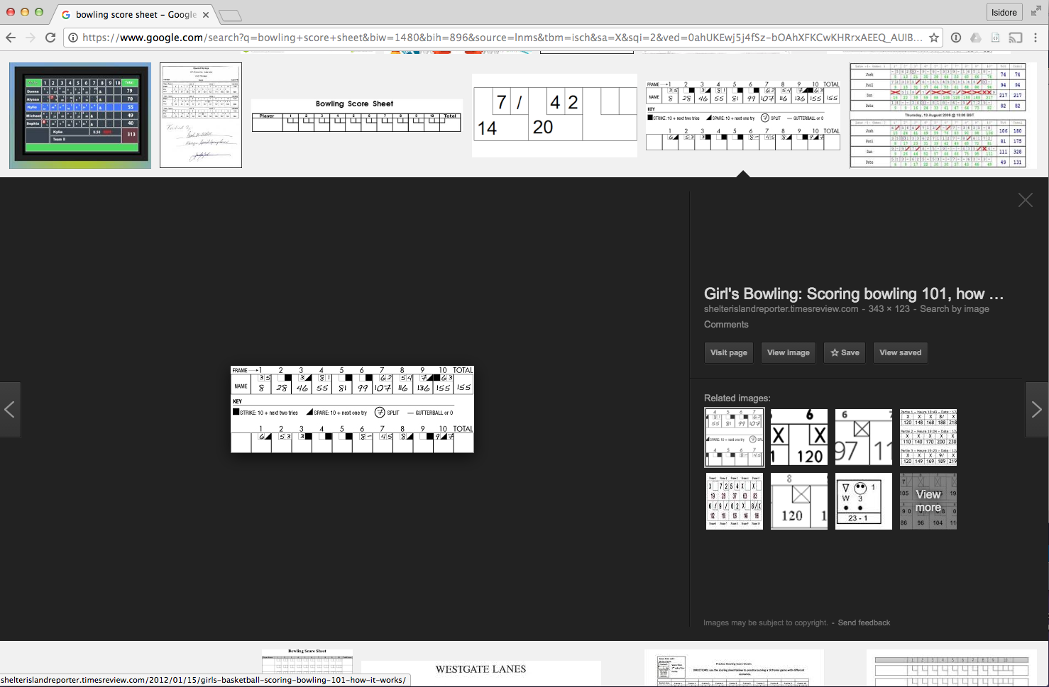
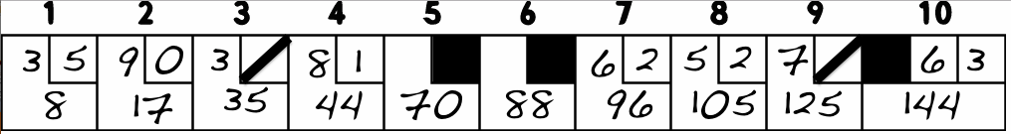

Slide 75
1) 3, 5 [8] = 8
2) 9, 0 [9] = 17
3) 3, 7 [18] = 35
4) 8, 1 [9] = 44
5) 10 [26] = 70
6) 10 [18] = 88
7) 6, 2 [8] = 96
8) 5, 4 [9] = 105
9) 7, 3 [20] = 125
10) 10, 6, 3 [19] = 144

Slide 76
https://github.com/isidore/Talks/blob/master/FakeItTillYouMakeIt.md

Slide 77

Thank YOU (please connect via LinkedIn and Twitter)
@LlewellynFalco
youtube.com/isidoreus
LlewellynFalco.Blogspot.com approvaltests.com

